Slide 1

Command Design Pattern
By Filip Crisan, Campean Catalin, Muresan Vlad
Babes-Bolyai University

Slide 2
Intent
Parameterize clients with requests.
1
Support undoable operations.
2
Encapsulate a request as an object
3
Delay, queue, or log requests.
4

Slide 3
Participants
Command
Declares an interface for executing an operation.
Concrete Command
Defines a binding between a Receiver object and an action.
Implements Execute by invoking the corresponding operation(s) on Receiver.
Invoker
Asks the command to carry out the request.
Receiver
Knows how to perform the operations associated with carrying out a request.
Any class may serve as a Receiver.
Client
Creates a Concrete Command object and sets its receiver.

Slide 4
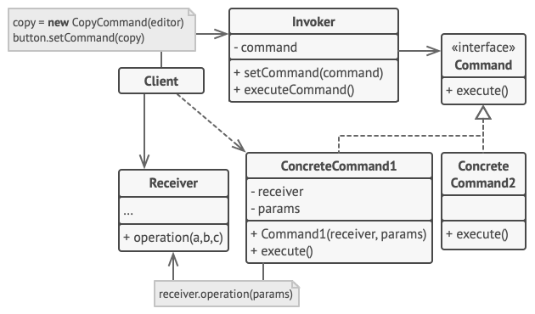
Structure
Fig.2: Structure [2]

Slide 5
Novelty
Decoupling the invoker of the operation from the one with the knowledge to perform it.
All of this is possible because the object that issues a request only needs to know how to issue it; it doesn't need to know how the request will be carried out.
Great flexibility in designing our UI. Because the Client (e.g. a view/component) can reference multiple Invokers (e.g. a button/menu item/shortcut) of the same Action (e.g. save entity/open dialog) using the same Concrete Command.

Slide 6
Applicability
Parameterizing objects with actions to perform, commands being the OOP replacement for callbacks.
Queuing commands to be executed later or even in a different process. A Command object can have a lifetime independent of the original request, meaning that if the receiver of a request can be represented in a address space-independent way, then you can transfer a command object for the request to a different process.
Supporting undo operations by adding an unexecute method to the Command interface. This is possible with the help of a state manager which keeps a history of commands on a stack.
Facilitating transactions: high-level operations built on primitive operations. Upon eventual failures, all successfully completed operations, until that point, will be rolled back.

Slide 7

Pros & Cons
Single Responsibility Principle. You can decouple classes that invoke operations from classes that perform these operations.
Open/Closed Principle. You can introduce new commands into the app without breaking existing client code.
You can implement undo/redo.
You can implement deferred execution of operations.
You can assemble a set of simple commands into a complex one.
The code may become more complicated since you’re introducing a whole new layer between senders and receivers.

Slide 8
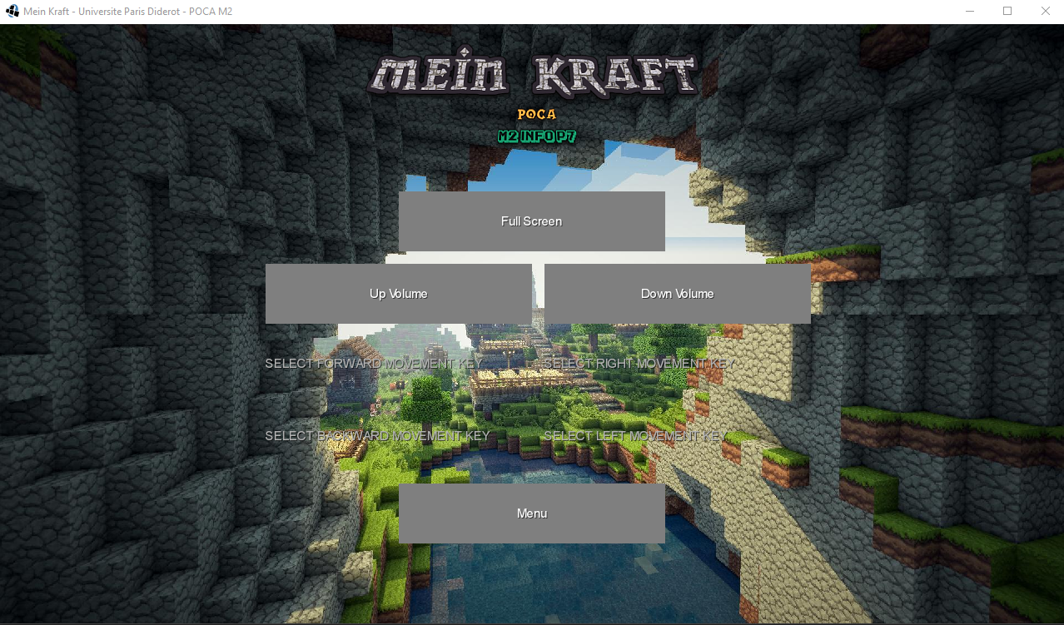
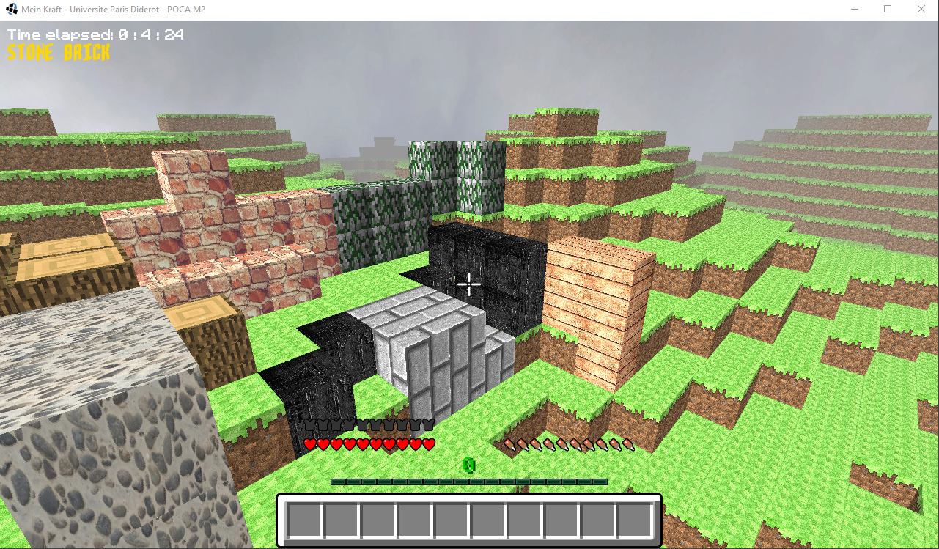
Case Study: Mein-Kraft-Terraform
a Minecraft-Inspired desktop game
Fig.2: Landing Screen [3]

Slide 9
Introduction of new forces
Gravity force is applied to the entire world.
Slippery terrain according to the biome.
The player character can bounce almost like a ball.
Parabolic fall when running and jumping (real-life jump).
Time portals
Novelties
Space teleportation

Slide 10
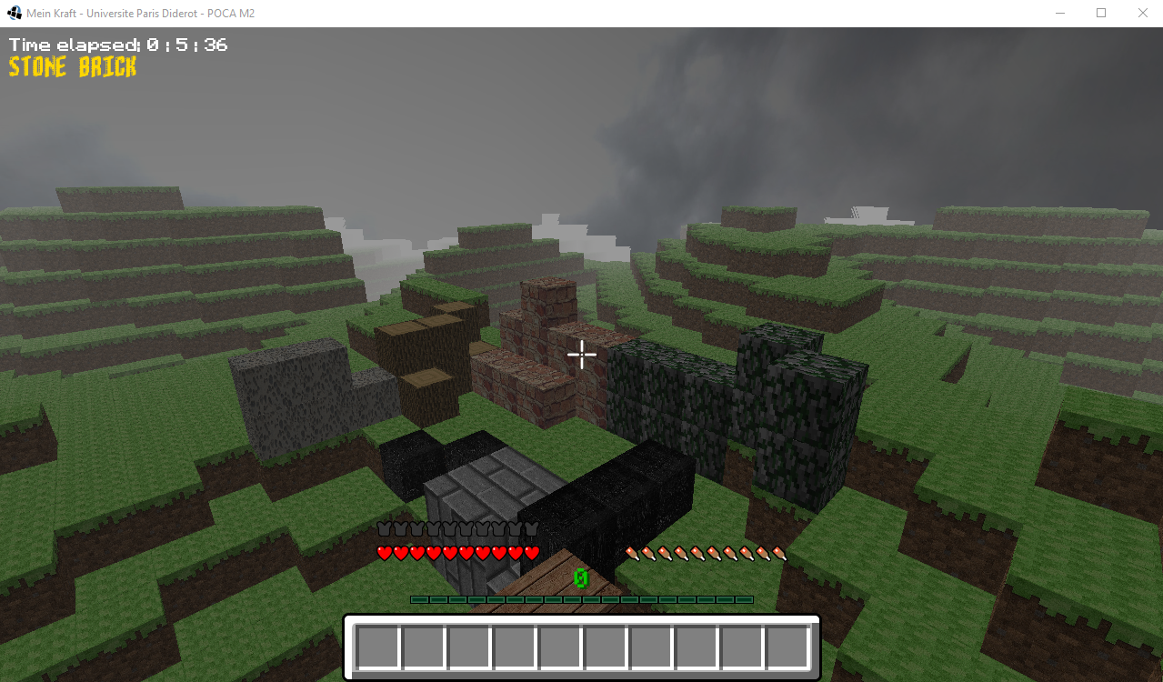
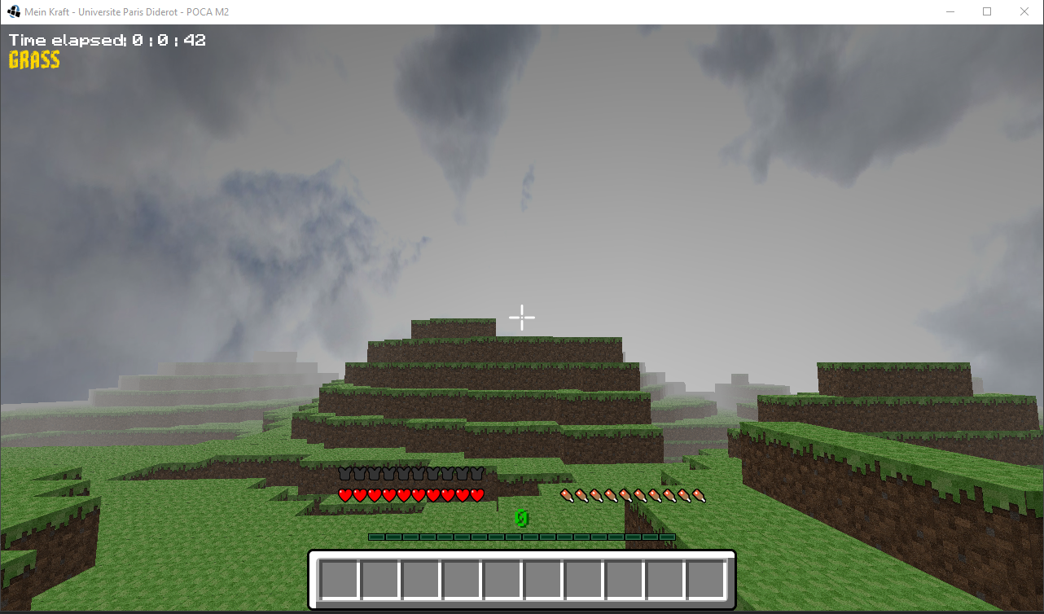
Pictures
Fig: In-Game Screens [3]

Slide 11
Command Pattern Integration
https://github.com/Aizen93/Mein-Kraft-Terraform.git

Slide 12
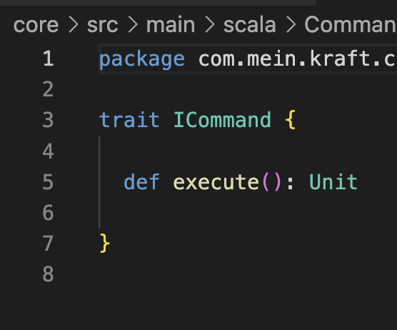
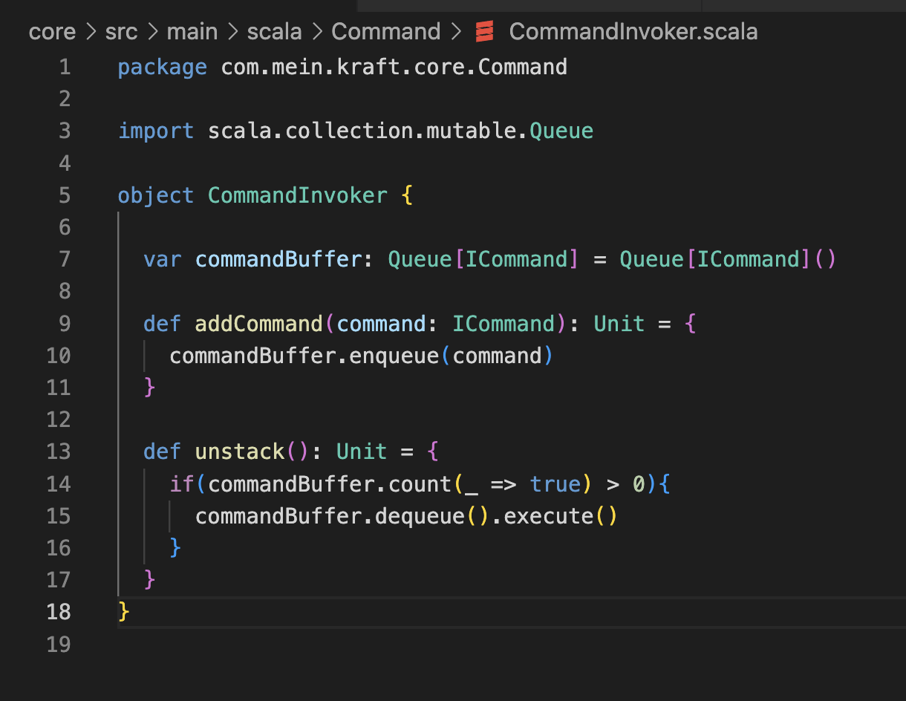
Interface & Collection

Slide 14
Interface & Collection

Slide 16
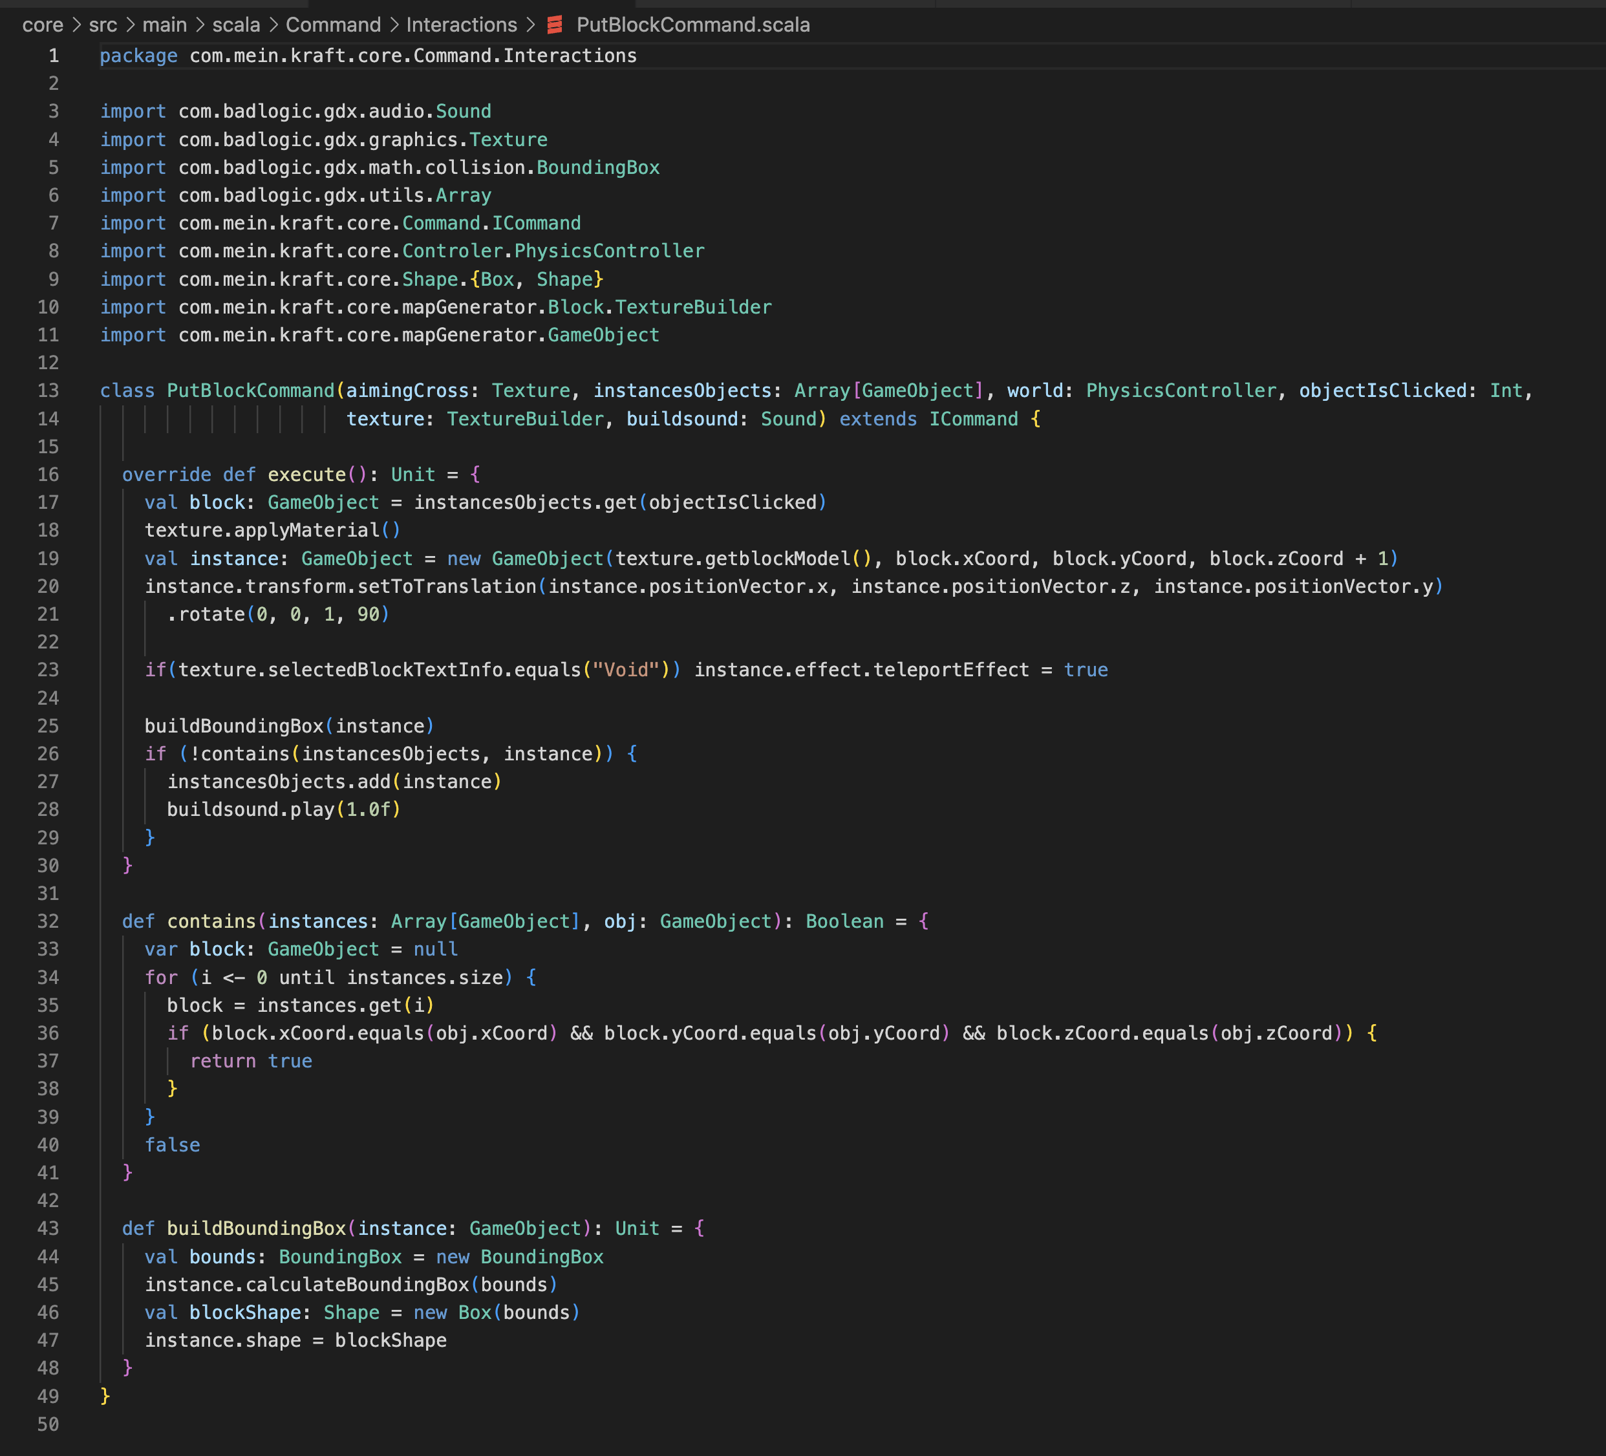
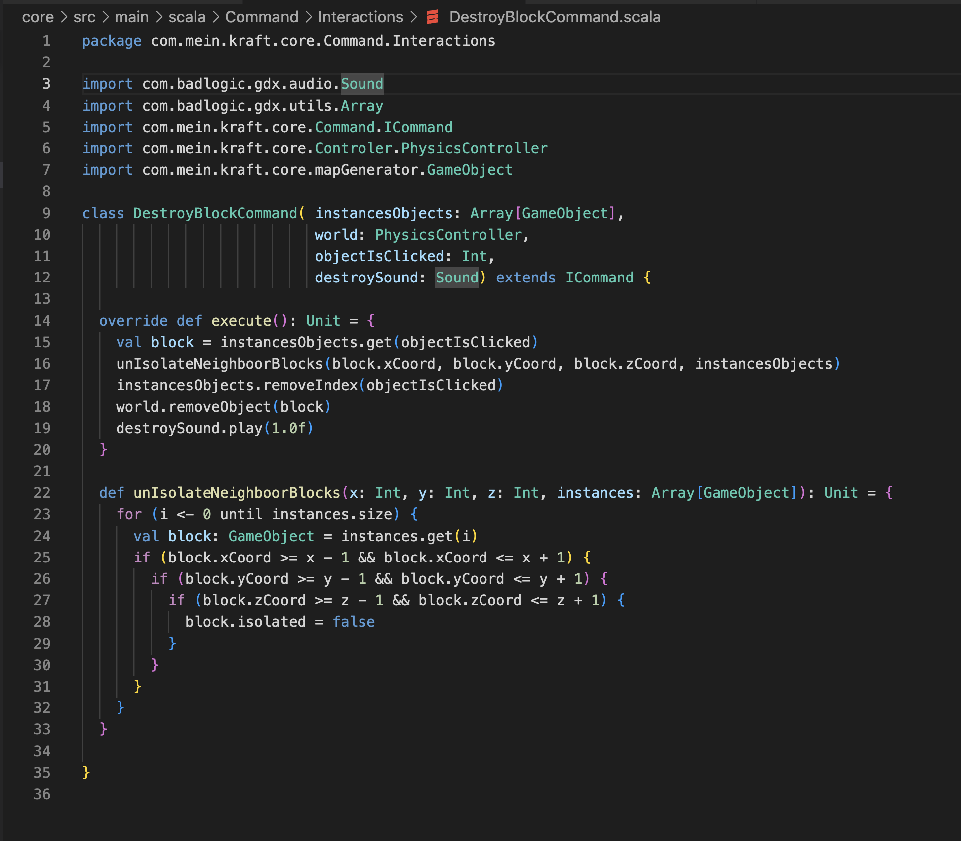
Put & Destroy Blocks

Slide 17
Put and destroy blocks

Slide 18
Put & Destroy Blocks

Slide 19
Put and destroy blocks

Slide 20
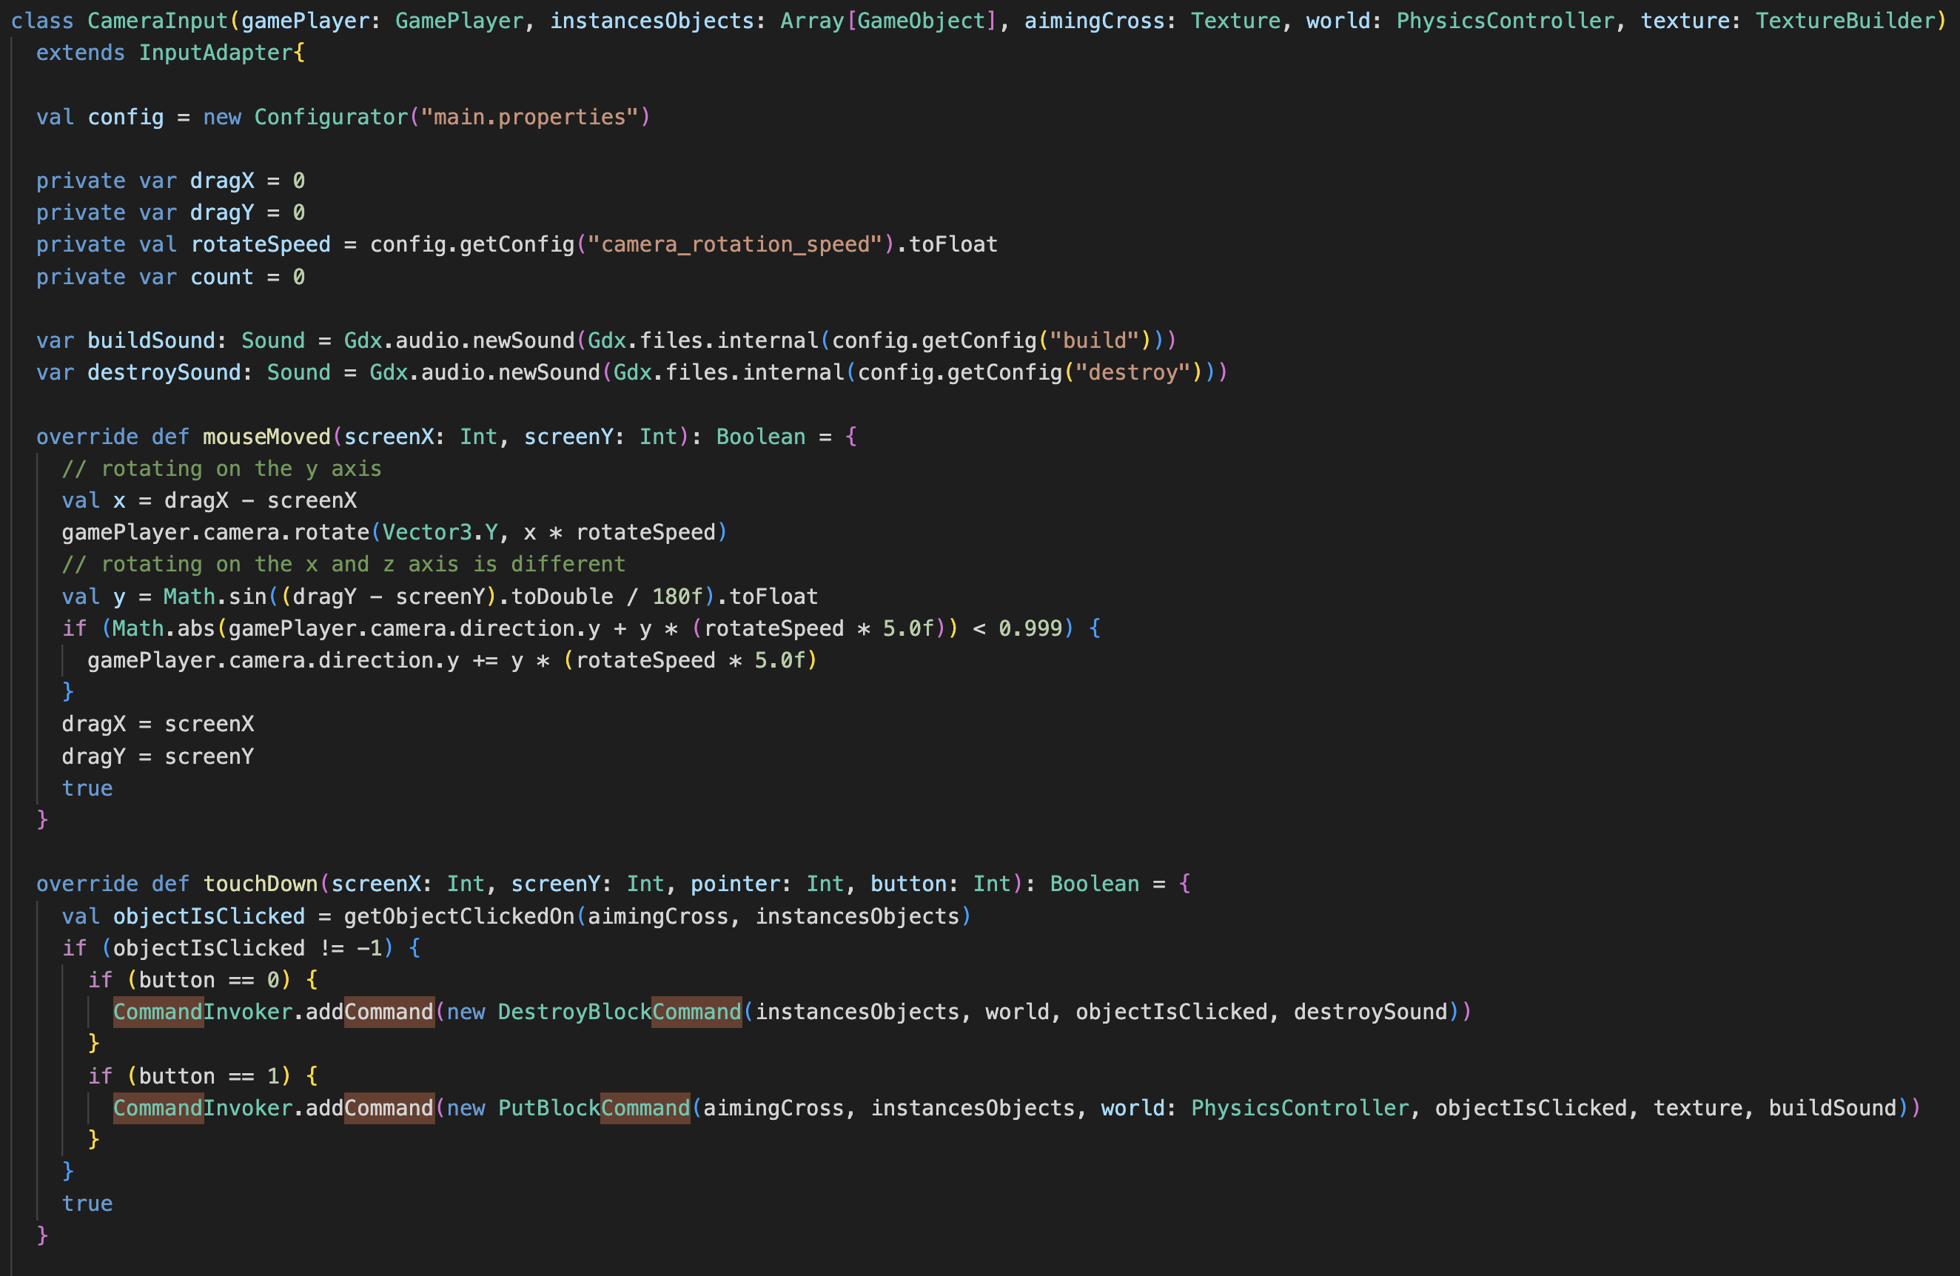

Slide 21
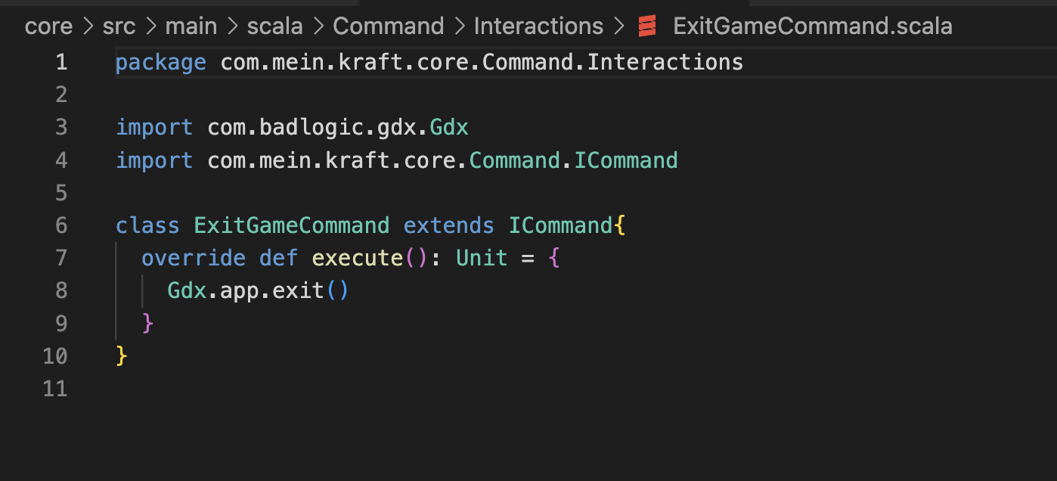
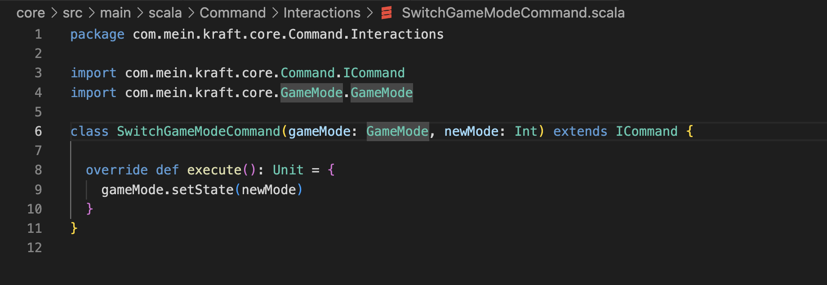
Exit Game & Switch Game Mode

Slide 23
Exit Game & Switch Game Mode

Slide 25
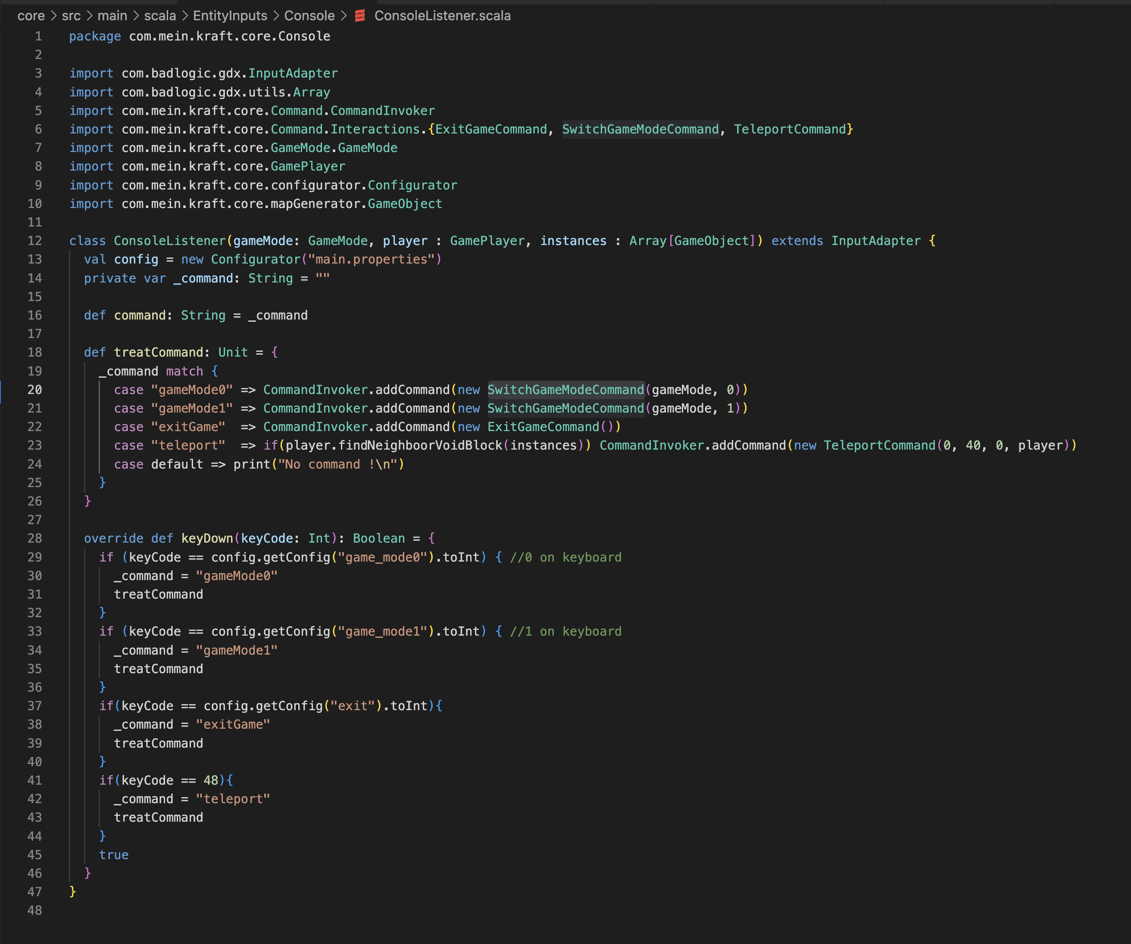

Slide 26
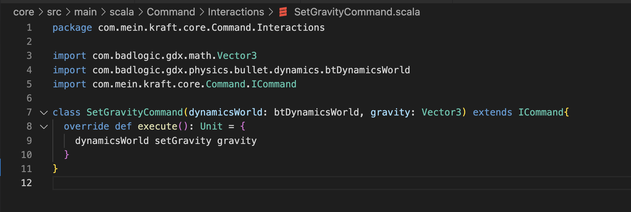
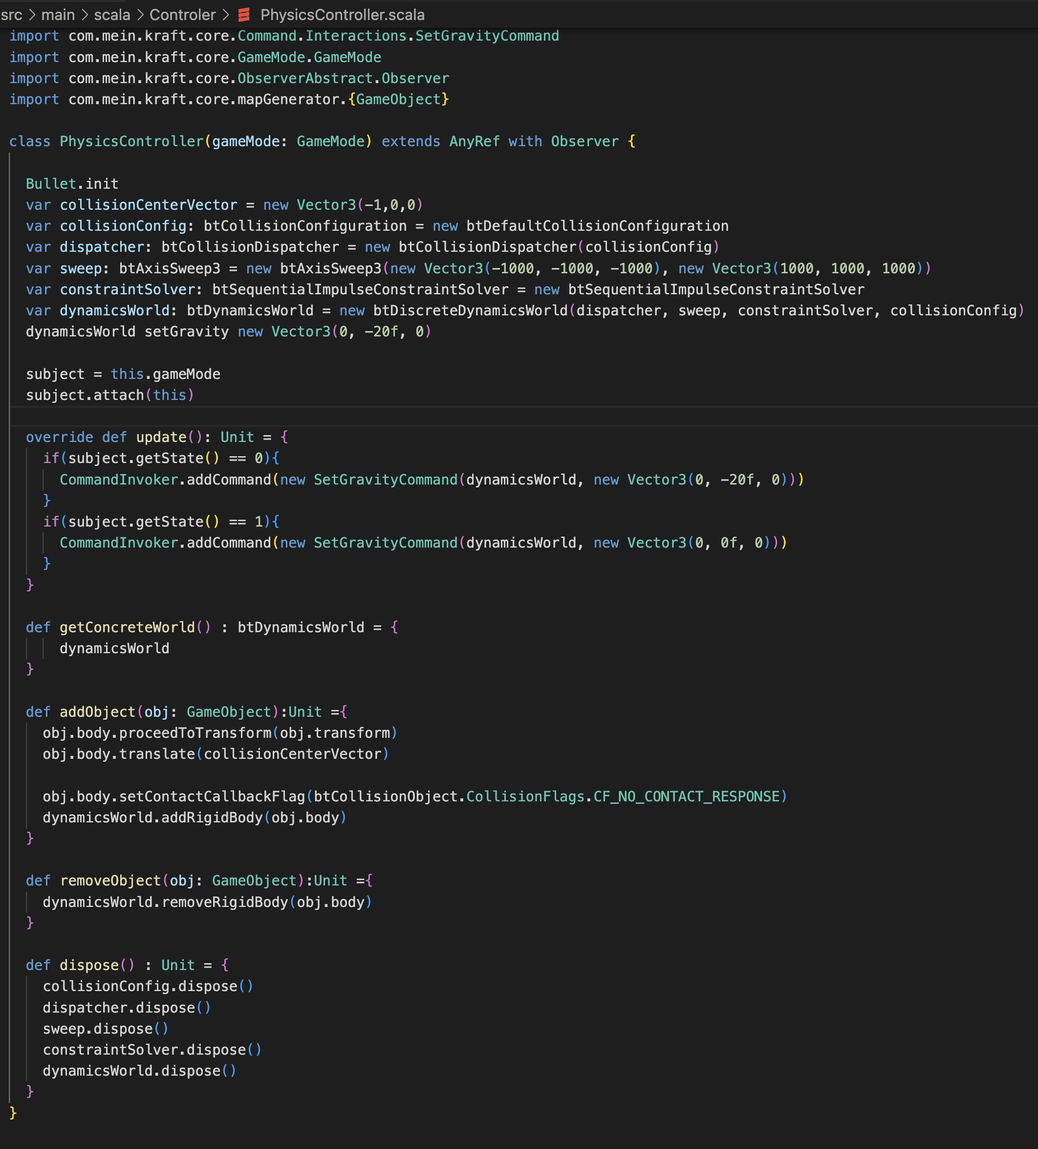
Gravity Force

Slide 28
Gravity Force

Slide 30
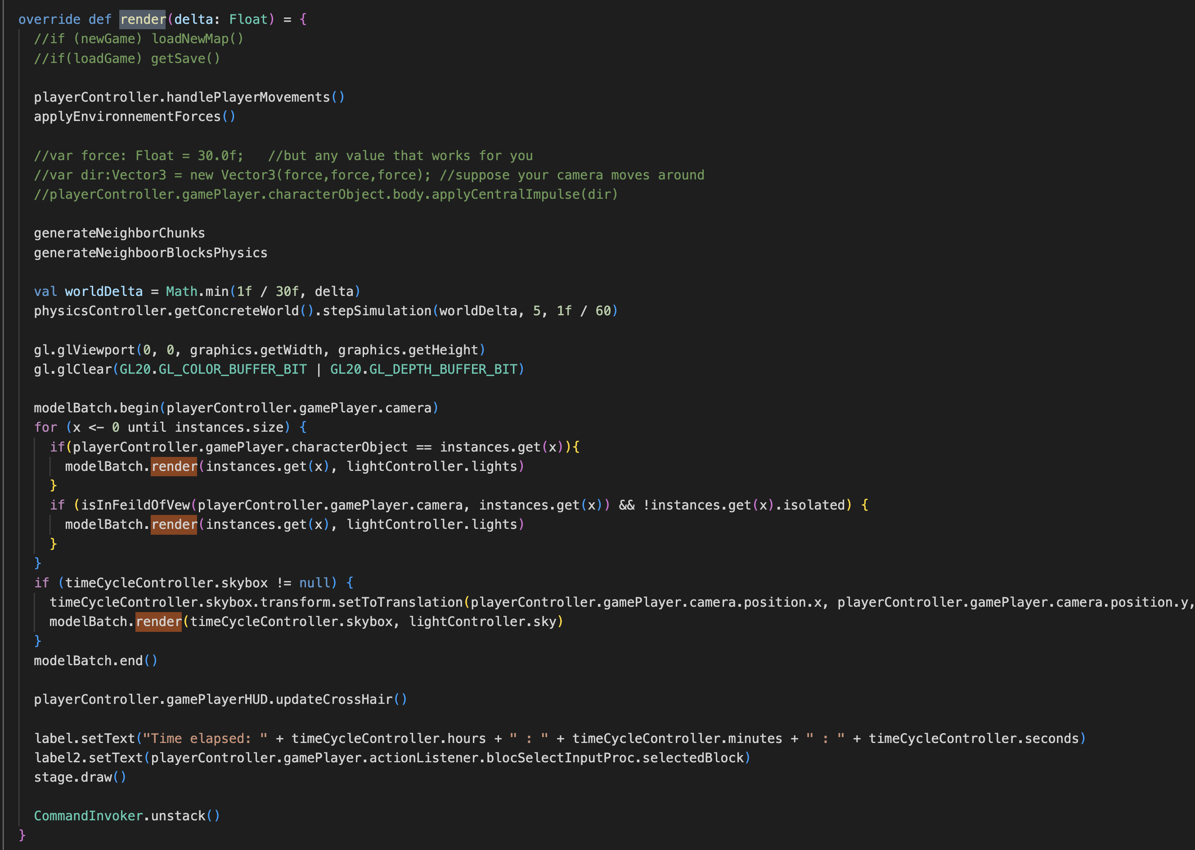
Executing Commands

Slide 32
Integration Recap
Needed for creating a callback-like system of chained actions
Use-cases :
Updating the way in which gravity is applied to certain elements of the screen
Placing and destroying blocks
Switching game modes and exiting the game

Slide 33

Case Study: Dataverse
a web-based research data repository
Fig.4: Official Website [4]

Slide 34
Command Pattern Integration
https://github.com/IQSS/dataverse.git

Slide 35
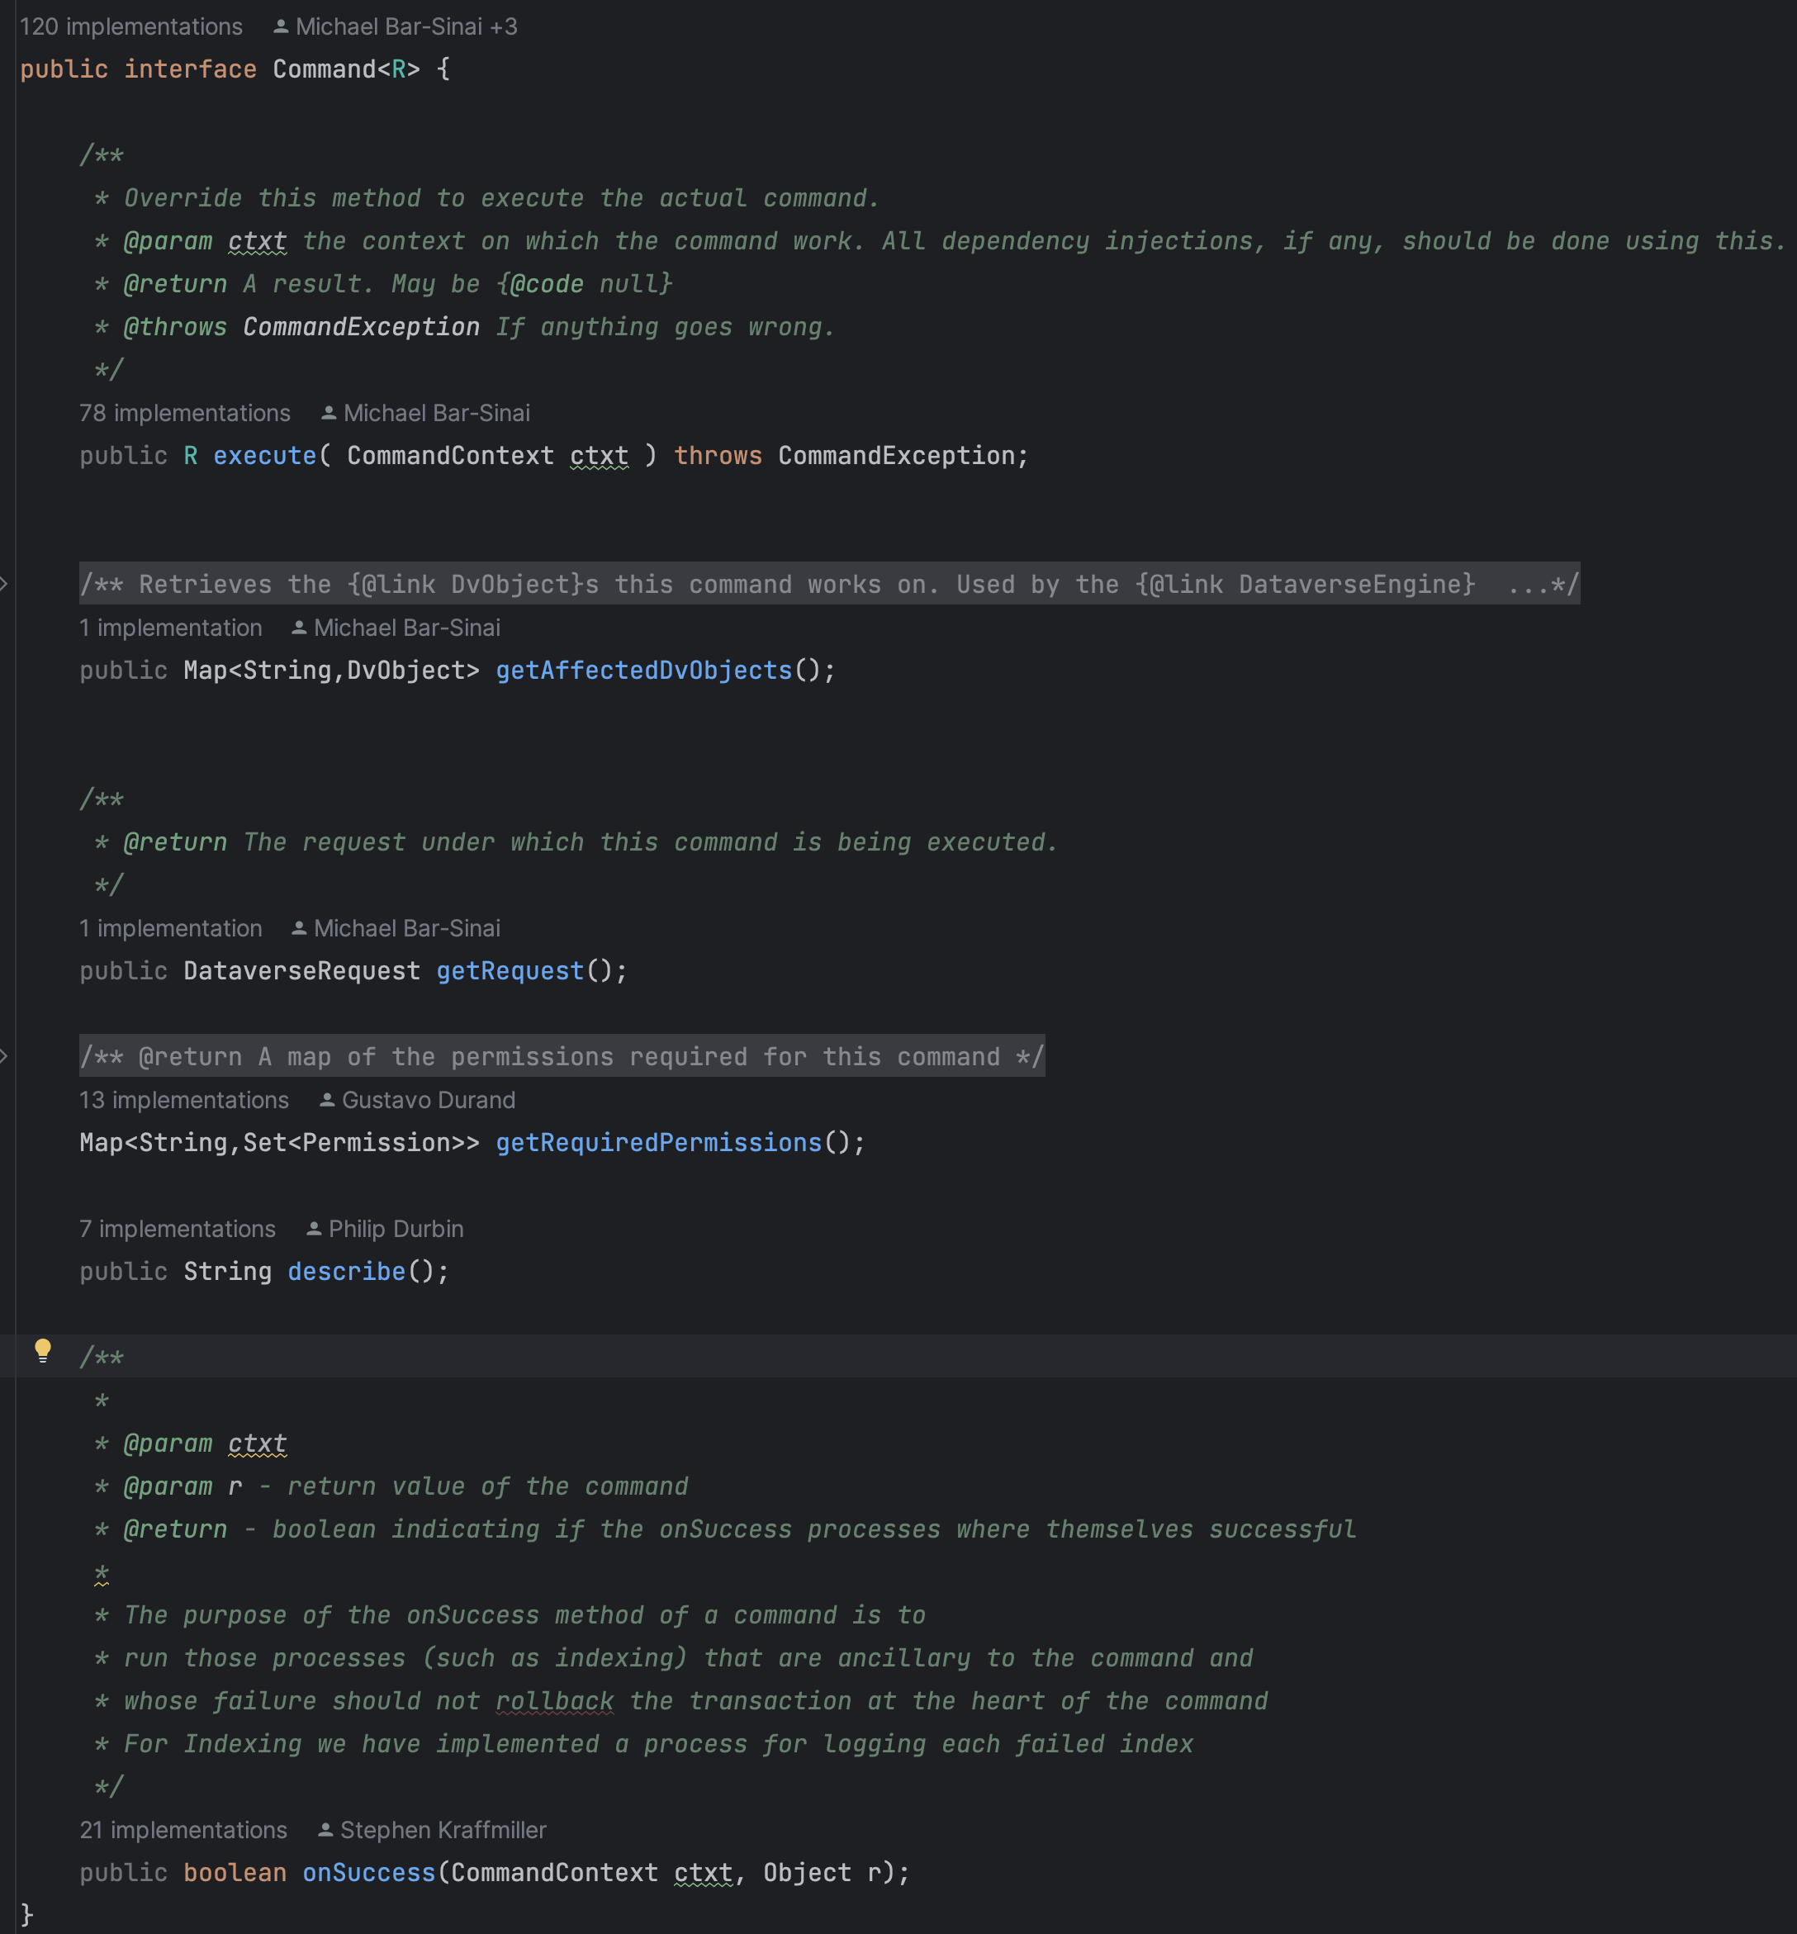
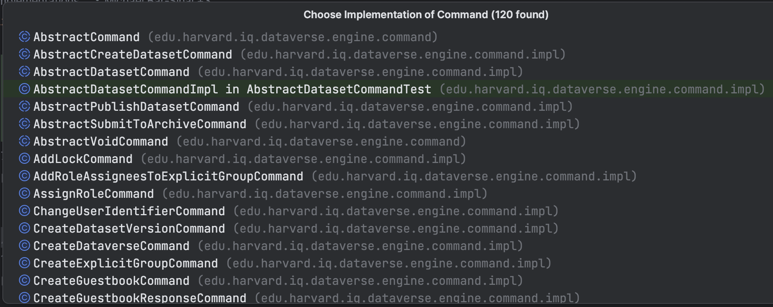
Interface & Usage

Slide 37
Interface & Usage

Slide 39
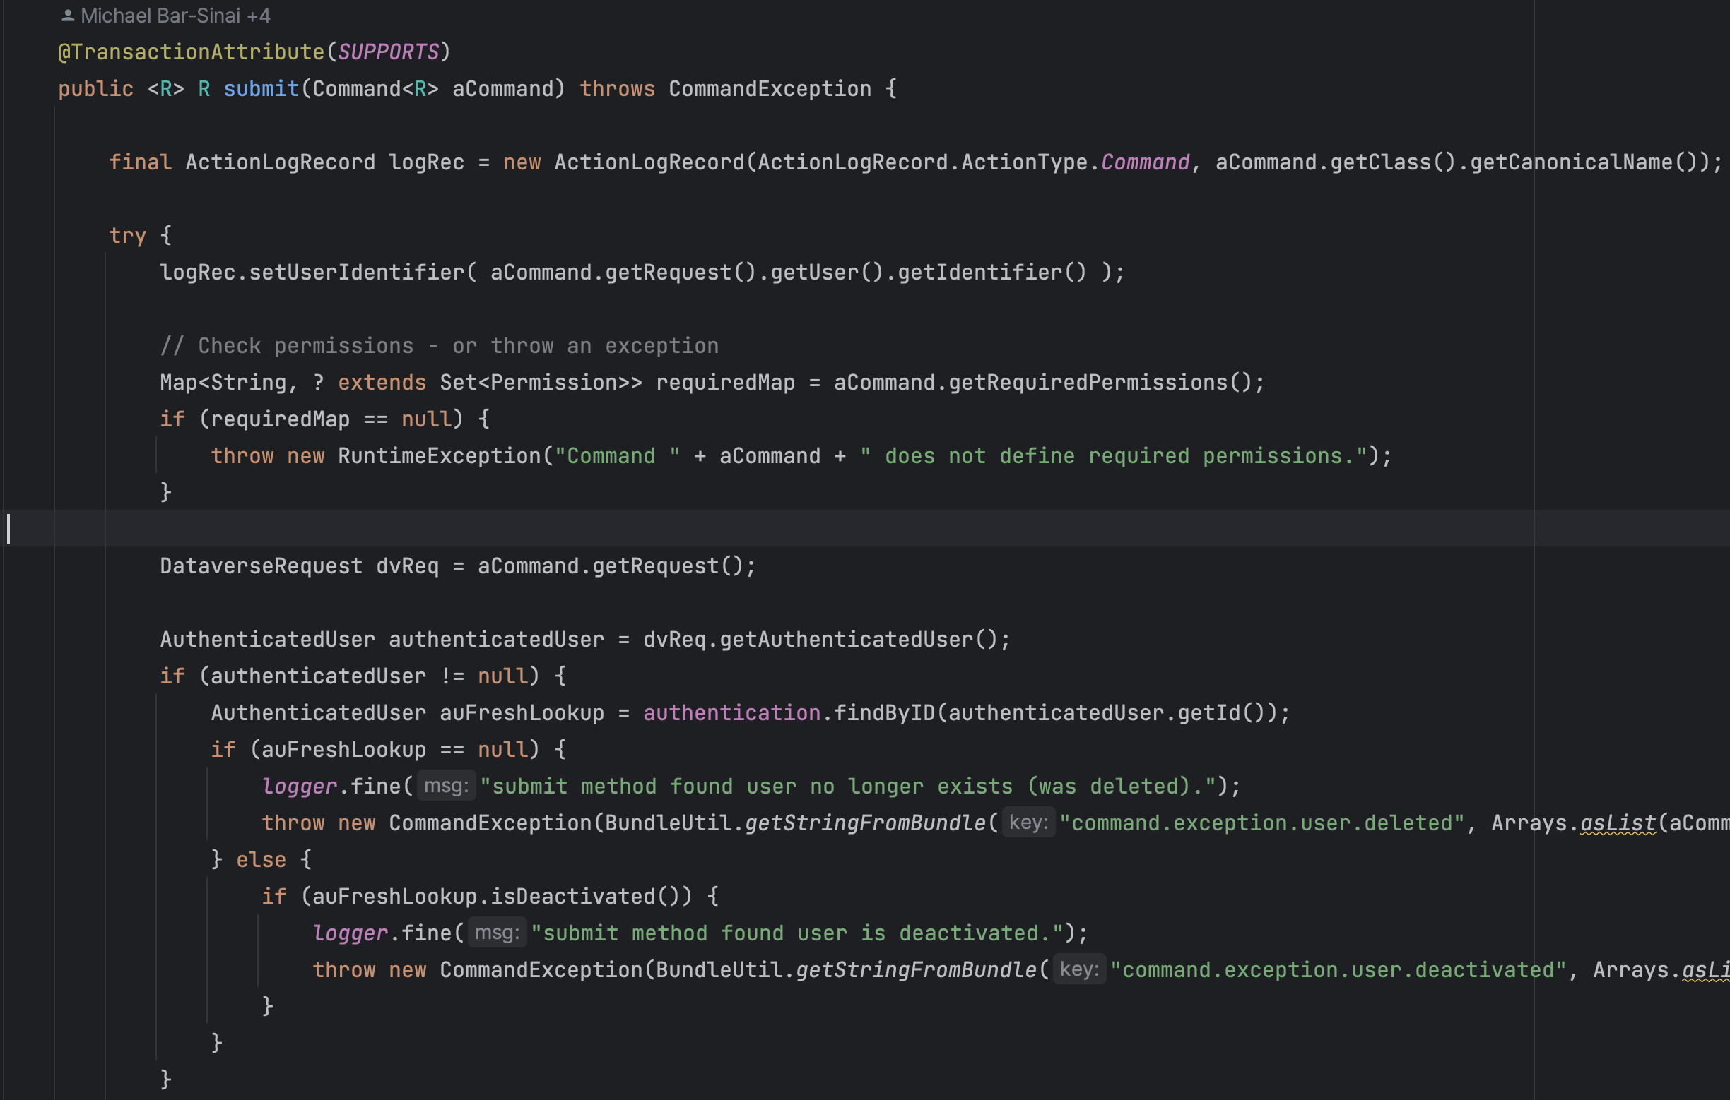

Slide 40
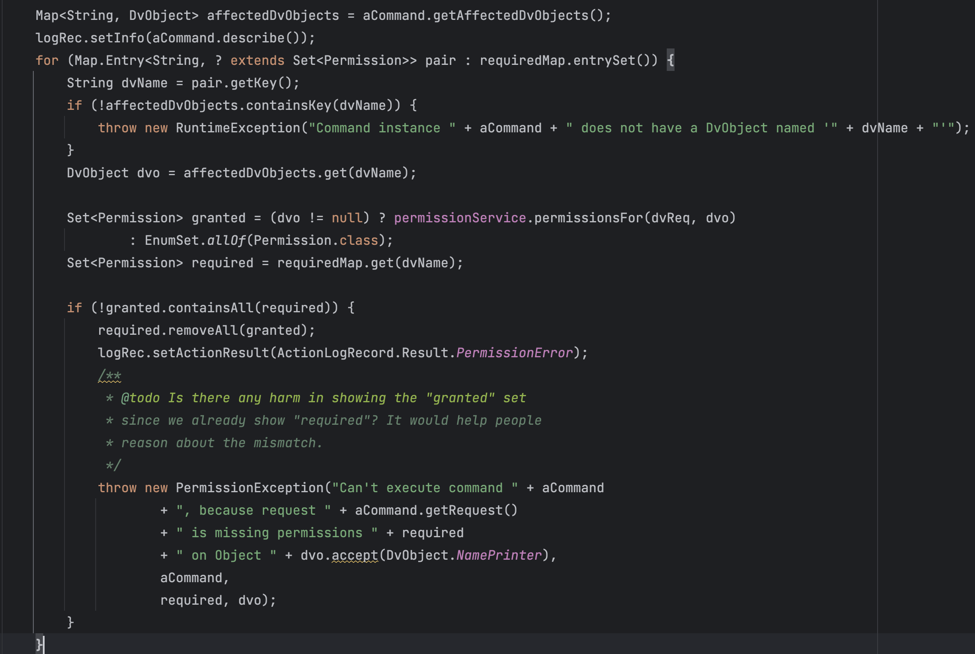

Slide 41
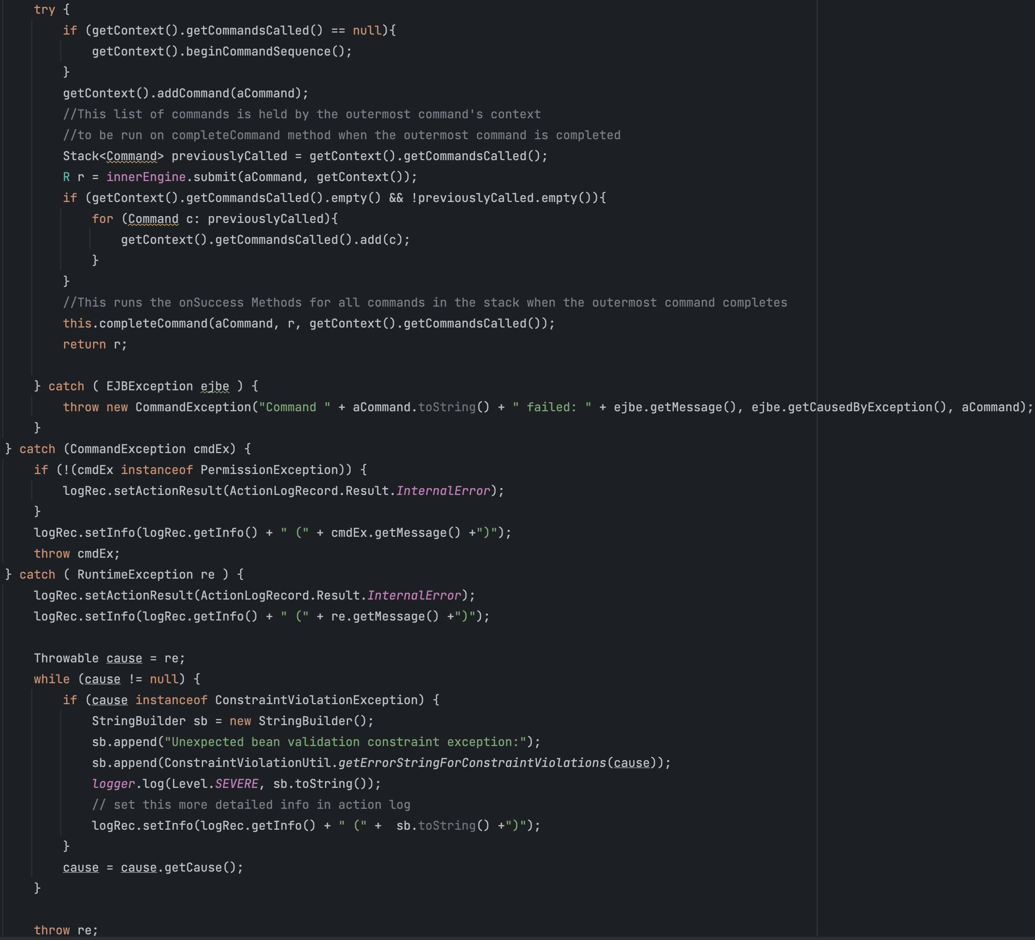

Slide 42
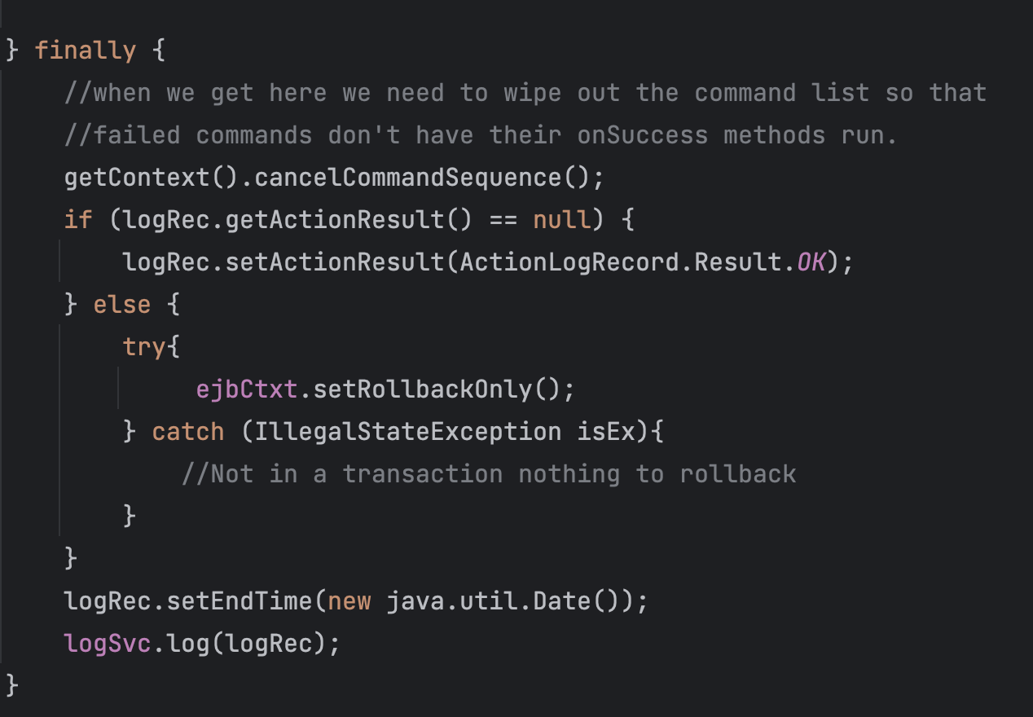

Slide 43
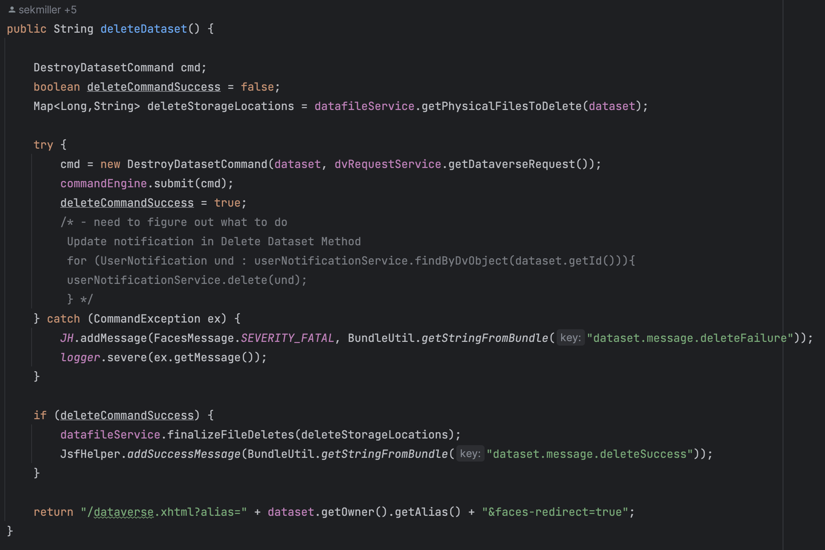
Example of Command Submission

Slide 45
Integration Recap & Improvements
Using an improved version of the traditional Command Pattern for validating user’s permissions over the objects the command should operate on
Current practices make it easy to state that only users with permission P can access resource R. However, it is not the case for performing action A over objects X and Y, where users need permission P1 on X and P2 on Y.
Use-cases :
120 implementations of the Command interface
Managing almost every object in the system (e.g. dataset, role, guestbook, template etc.) and its associated actions (create, read, update and delete)

Slide 46
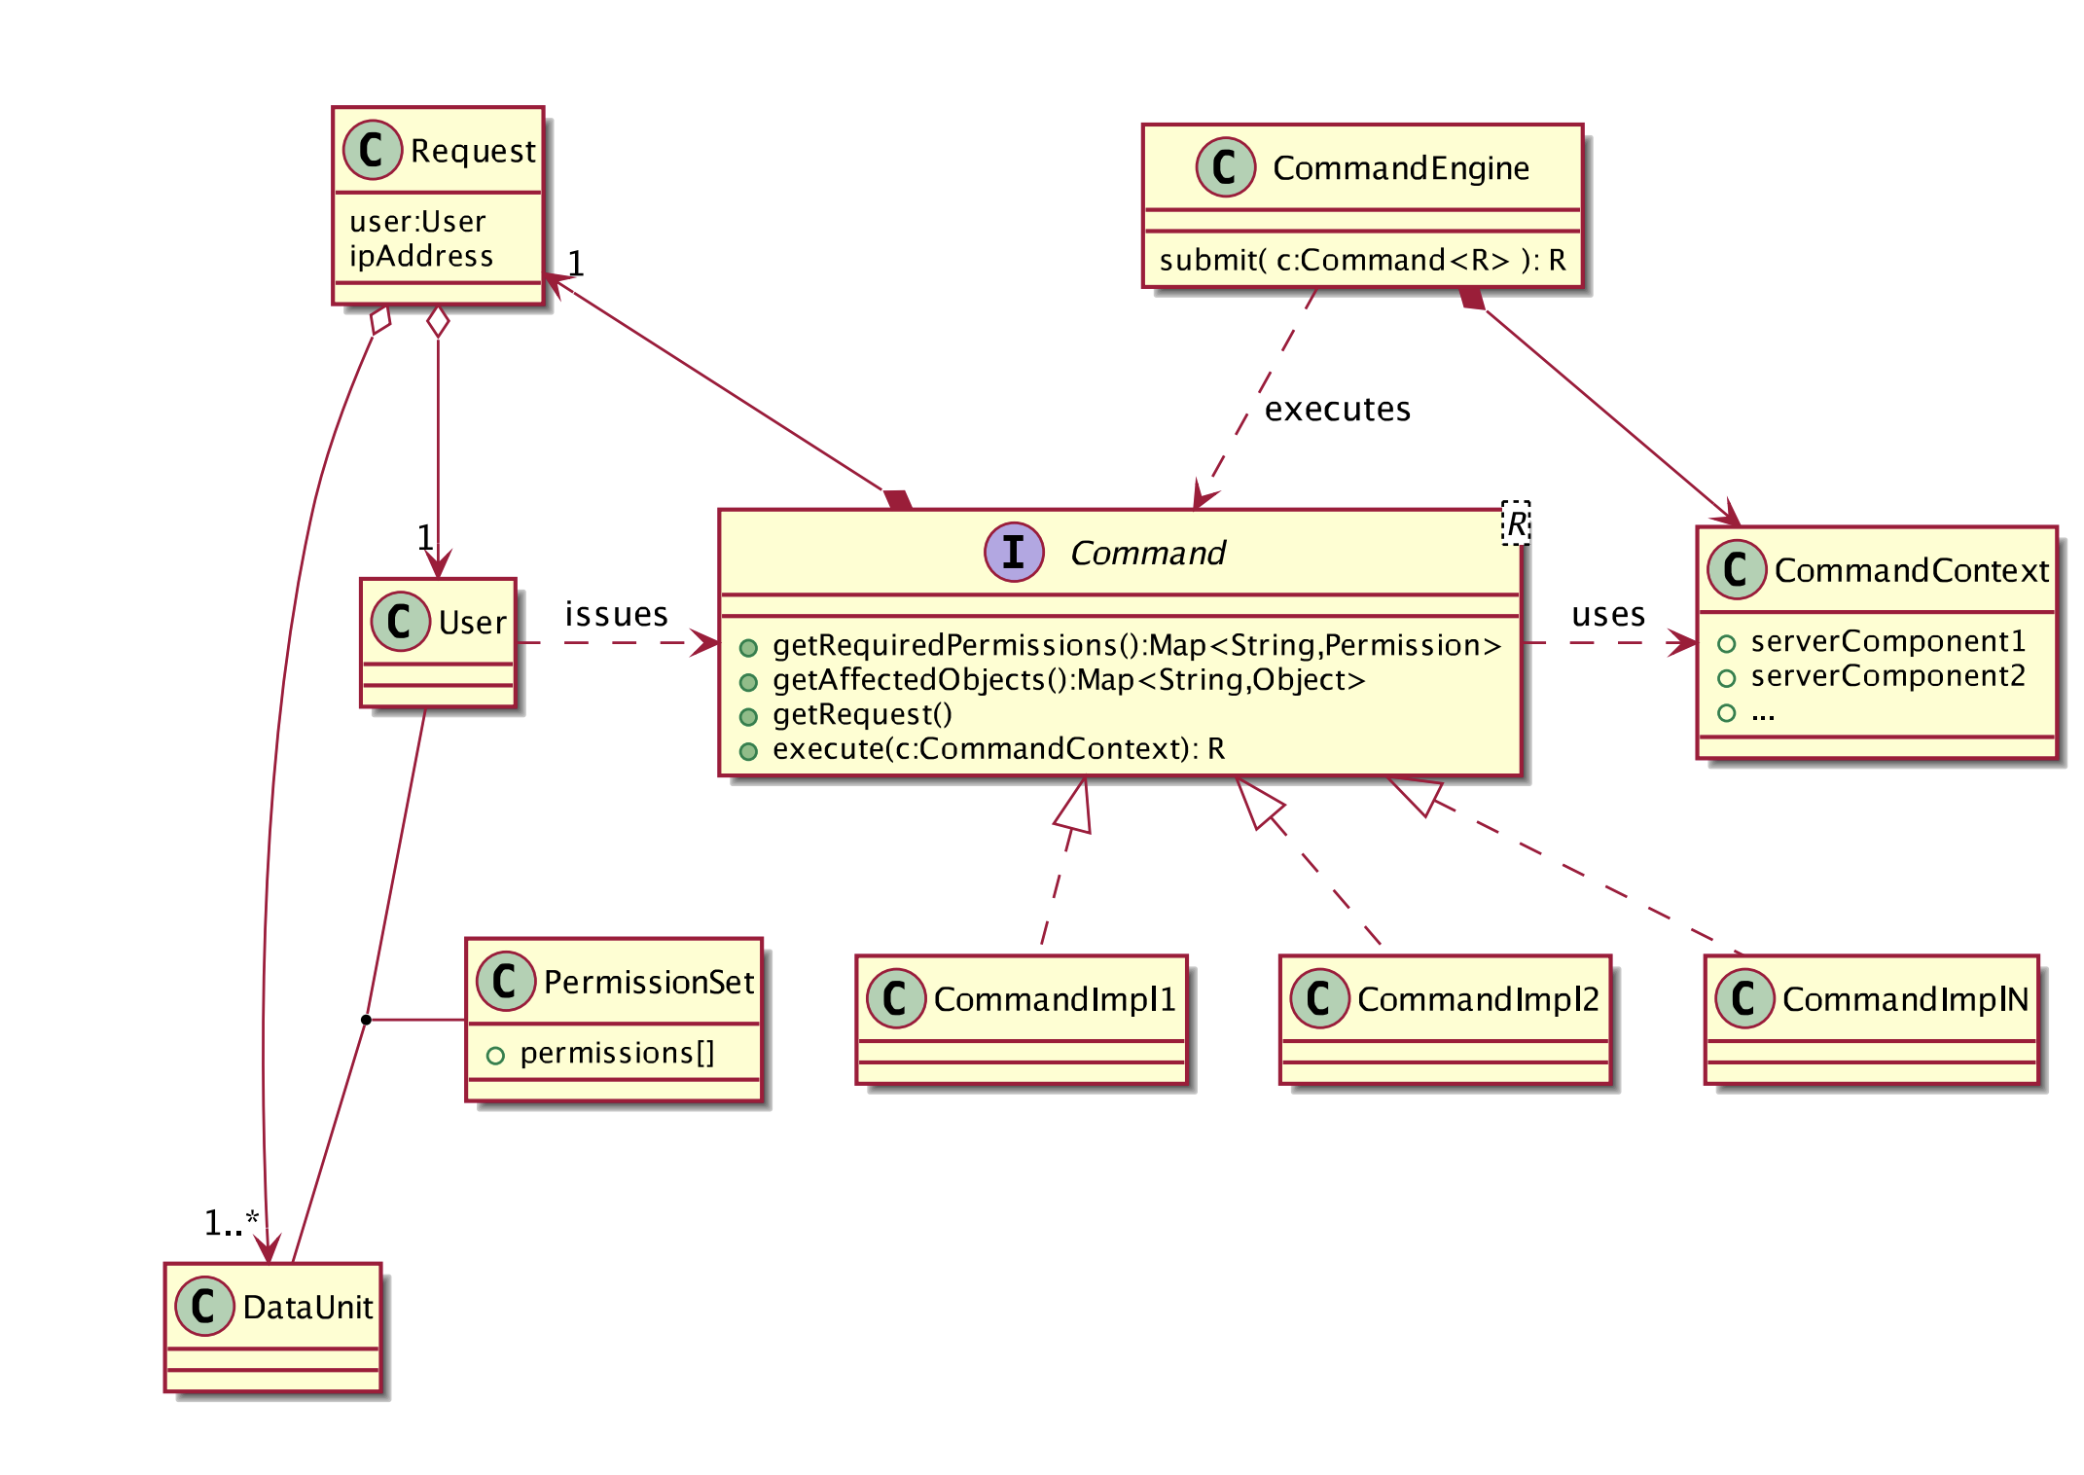
Structure
Fig.5: Official Website [4]

Slide 47
Kwestions?
Koncerns?
Suggestions?

Slide 48
Bibliography
[1] “Design Patterns Elements of Reusable Object-Oriented Software” by Erich Gamma, Richard Helm, Ralph Johnson, John Vlissides, 1st Edition, Publisher: Addison-Wesley Professional, ISBN-10: 0201633612
[2] https://refactoring.guru/design-patterns/command
[3] https://github.com/Aizen93/Mein-Kraft-Terraform.git
[4] “Securing Dataverse with an Adapted Command Design Pattern” by Gustavo Durand, Michael Bar-Sinai, Merce Crosas

